Slide 1


ScrapeSmart
Venture Viability Analysis
Sri Sairam Engineering College, west Tambaram

Slide 2

ScrapeSmart
ScrapeSmart uses AI to streamline web scraping, providing businesses with accurate, actionable data.
Sri Sairam Engineering College, west Tambaram

Slide 3




Venture Team
Name: GOKUL SIVA
Major: CSE
Name: Prasanth Babu A K
Major: CSE
Name: MOHAMMED ZUBAIR R
Major: CSE
2

Slide 4
Context
Businesses face web data extraction challenges due to technical, legal, and cost barriers.
3

Slide 5
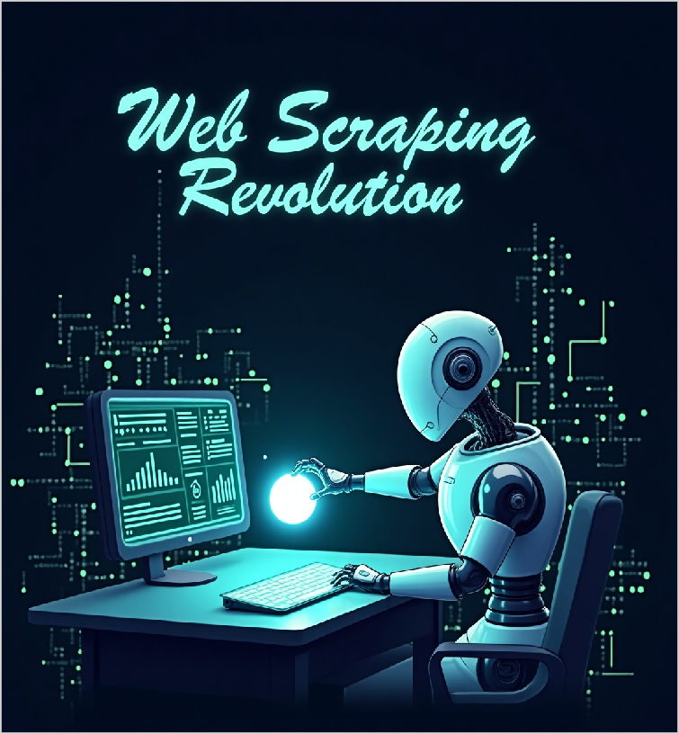
Problem Statement
Problem
We aim to solve inefficient, time-consuming web data collection with an AI-driven, ethical scraping tool.
Impact
Businesses waste time on data collection, websites risk data theft, and regulators face privacy issues.
4

Slide 6

Problem Statement/Industry
Problem Being Solved
Many individuals and businesses struggle to collect, organize, and analyze online data efficiently due to technical barriers, website restrictions, and evolving anti-scraping measures. This limits access to valuable insights, making data-driven decision- making difficult for non-technical users and small businesses without specialized resources.
Supporting Data
Businesses face web data
extraction challenges due to
technical, legal, and cost barriers.
Source: Sources: Zyte Web Scraping Report, PromptCloud Survey, Wikipedia, FTF News.
Area
Business Services
Industry
Technology
Domain
Data Analytics

Slide 7



Problem Analysis
Affected Stakeholders
Small businesses & startups – Lack resources and expertise for data collection. Market researchers & analysts – Struggle with accessing real-time, structured data. E-commerce businesses – Face challenges in tracking competitor pricing and trends. Journalists & researchers – Encounter difficulties in gathering and verifying online information.
Impact on Stakeholders
For your AI-driven web scraping solution: Users: Save time, access data faster, but could misuse it, leading to legal issues. Websites: Risk data theft, but can gain traffic if done ethically.
Regulators: Concern over data privacy, potential legal challenges.
Competitors: Increased innovation, but higher competition. Consumers: Access valuable
Root Causes
The root causes for the ongoing issue of AI-driven web scraping include: Lack of Regulations: No universal guidelines for ethical scraping. Privacy Concerns: Insufficient protection of sensitive data. Website Inconsistencies: Constant changes to website structures. Resource
Demands: High processing power for large-scale scraping.
Personal/Team Connect
As a team with diverse backgrounds in technology, business, and data science, we are passionate about
improving data accessibility and efficiency. We understand the challenges that businesses and researchers face in gathering reliable, real- time information. Our goal is to solve this problem with AI, making web scraping easier, faster, and ethical.

Slide 8

Target Customer Segments
Primary
Data-driven businesses and independent
researchers seeking
efficient web data extraction.
Secondary
Startups and small-
scale SaaS developers looking to integrate affordable,
scalable web scraping
5

Slide 9

Customer Segment & Persona
Primary Segment
Data-driven businesses and independent researchers seeking efficient web data extraction.
Persona
Secondary Segment
Startups and small-scale SaaS developers looking to integrate affordable, scalable web
scraping
John Doe
Age in years: 35 Location: Metropolitan
Organizational Role:
{Persona's primary role}
(if applicable)

Slide 10

Jobs-to-be-Done
Functional JTBD
John wants to extract data from websites easily, without coding. He needs to collect, clean, and format info like prices or reviews,
automate scraping, avoid IP bans,
track changes, get alerts on errors, and integrate results into his tools—all while staying legally compliant.
Emotional JTBD
John wants to feel confident, in control, and less stressed about web scraping. He seeks ease, reliability, and empowerment
without coding. He wants to feel
productive, safe, and proud using smart tools that save time, adapt to changes, and keep his work ethical and efficient.
Social JTBD
John wants to gain recognition as a smart, efficient problem-solver. He hopes colleagues or clients see him as tech-savvy and
forward-thinking. He wants to
share insights confidently, earn respect for his skills, and be seen as someone who leverages AI to stay ahead.

Slide 11


Current Alternatives
Current Alternatives
John currently uses manual copy-paste, writes Python scripts, or uses tools like Octoparse or ParseHub. He may hire freelancers, use
browser extensions, or rely on public APIs and
paid datasets. These options are often time- consuming, costly, or need technical skills and constant maintenance.
Gaps in Current Alternatives
Existing solutions are often too technical, time- consuming, or costly for John. Scripts break
when websites change, tools have usage limits,
and manual work is slow. He feels frustrated by frequent errors, lack of flexibility, and the need for constant updates, making data collection
unreliable and inefficient.

Slide 12
Problem Validation (GOOTB)
Partial List of Potential Customers/Users Interviewed
Problem Validation
Total customers/users interviewed:
In-person: 1
Virtually: -1
Total customers/users for whom this problem is important to
solve: 2
Total customers/users who are dissatisfied with the current alternatives: 1
Name: Prasanth Babu A K
Occupation: STudent
Name: Mohammed Zubair
Occupation: Student
Name: Roshan S
Occupation: Student

Slide 13
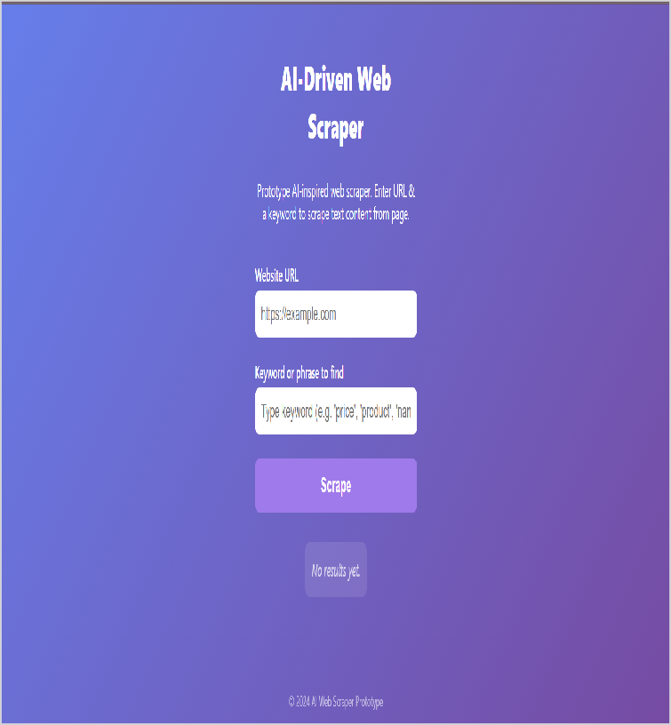
Our Solution
Solution
ScrapeSmart – An AI-powered web scraping tool that lets users extract web data using natural language, adapts to site changes, and ensures ethical, no-code data collection for researchers and business
Core Technologies/ Methodologies
The solution will use Python for backend, BeautifulSoup and Selenium for web scraping, Scrapy for automation, and AWS for cloud deployment.
6

Slide 14

Solution Design
Our Solution
ScrapeSmart – An AI-powered web scraping tool that lets
users extract web data using
natural language, adapts to site changes, and ensures ethical,
no-code data collection for
researchers and business
Key Features
The AI-driven web scraping tool will offer automated data extraction, customizable scraping rules, real-time
processing, scheduling, error
handling, machine learning analysis, and cloud storage.
Uniqueness
ScrapeSmart leverages AI to
intelligently scrape and analyze web data, offering businesses accurate insights with
optimized efficiency, making
research more accessible and actionable for users.
Solution Format:
AI-driven web scraping tool for businesses
Core Technologies/ Methodologies:
The solution will use Python for backend, BeautifulSoup and
Selenium for web scraping, Scrapy for automation, and AWS for cloud deployment.

Slide 15

Solution Benefits
Functional Benefits
Users will efficiently gather and analyze data from various websites, automate repetitive tasks, save time on
manual data extraction, and gain insights to
make informed business decisions or research
Emotional Benefits
Users will feel empowered by automating data
collection, reducing stress, and gaining confidence in accessing
valuable insights quickly, making data- driven decisions with ease.
Social Benefits
Users will gain recognition for being efficient and innovative, impressing colleagues and clients with their ability to leverage AI for data gathering and
making data-driven decisions.
Macro Benefits
AI-driven web scraping boosts productivity by automating data collection, enabling faster insights. This drives innovation, enhances business
efficiency, and supports economic growth.

Slide 16


Competitors
Direct
Scrapinghub,Octoparse Scrapy,ParseHub
Indirect
ZyloTech,Fractal Analytics Zapier,UiPath
Our UVP
AI-powered web scraping tool that adapts to site changes, no-code, saving time and boosting accuracy
7

Slide 17

Competitors
Direct Competitors
Scrapinghub,Octoparse
Indirect Competitors
ZyloTech,Fractal Analytics
Direct Competitors Globally
Scrapy,ParseHub
Indirect Competitors Globally
Zapier,UiPath

Slide 18
Macro Analysis
Favourable Trends
AREA | DESCRIPTION
Technology | Growing demand for AI and big data solutions.
Technology | Increased automation in business processes.
Unfavourable Trends
AREA | DESCRIPTION
Technology | Stricter data privacy regulations could limit web scraping capabilities.
Technology | Increasing competition from advanced automation tools.
Data Sources:
I referenced general industry knowledge from sources like the Gartner AI Trends Report 2024, McKinsey Automation Insights, and GDPR/Data Privacy Regulations publications.

Slide 19
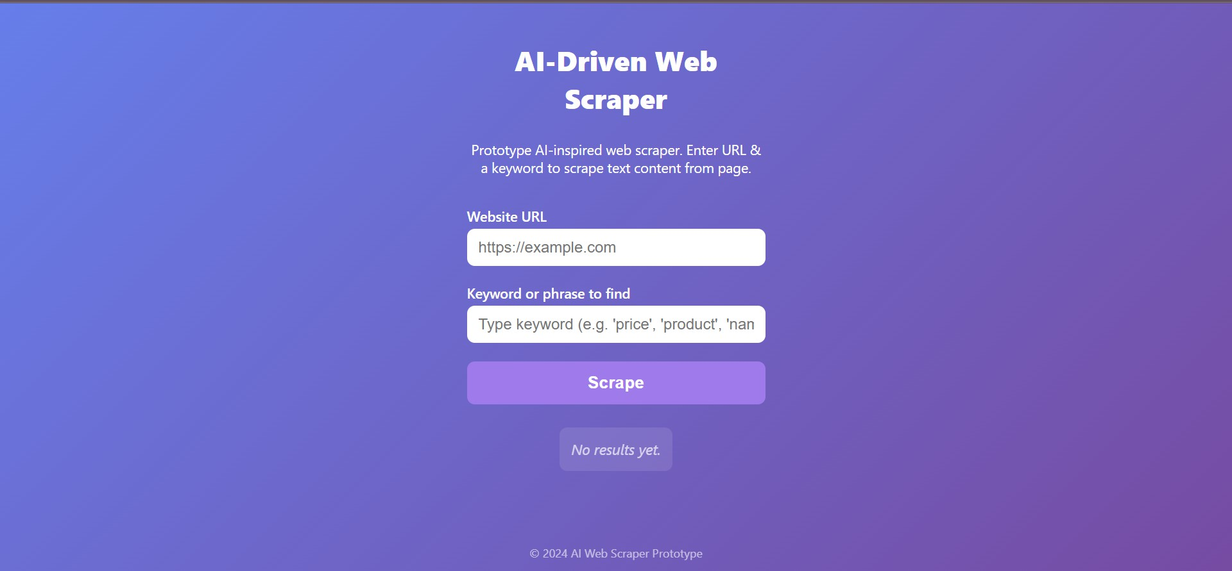
Prototype
Prototype Format
Digital prototype: Live demo of AI web scraper processing data to dashboard.
Functionality included in the Prototype
Core demo: 1) AI-powered scraping 2) Auto data cleaning 3) Real- time dashboard 4) Anti-blocking tech 5) Ethics compliance checks.
{Upload another picture}
Functionality NOT included in the Prototype
Excluded: 1) Multi-language support 2) Cloud auto-scaling 3) Custom API builder 4) User authentication 5) Advanced analytics. Focus
remains on core AI scraping reliability.

Slide 20
Prototype Validation
Number of users engaged with?
3
How many people liked or loved the prototype?
2
How many people were either neutral or mostly unhappy with the
prototype?
0
Prototype Feedback
What aspects of the prototype did the users LOVE? Users praised: 1) AI's accuracy in messy websites, 2) One-click CSV exports, 3) Real-time dashboard visuals, and 4) Ethical scraping alerts. Analysts called it 'a time-saver for reports. | What aspects of the prototype were DISLIKED by the users? Feedback: 1) Steep learning curve for non-techies, 2) Limited site-type customization, 3) CAPTCHA fails on heavy sites. Admins disliked lack of whitelist controls.

Slide 21
Competition Analysis
COMPETITOR NAME | TYPE | STRENGTHS | WEAKNESSES
ScrapingHub | Direct | Powerful scraper Dev Community | Needs Coding Skills Complex for new
OctoParse | Direct | No-code scraper Easy to use | Low scalability Limited control
ParseHub | Direct | Visual scraper Cloud support | Slow for big jobs Basic AI logic
DiffBot | Direct | AI-powered crawl Structured data | Complex to start Less control
Our Product/Service will be better than the competitors' solutions because:
Smart data extraction using AI/ML, auto-adapts to site changes, no-code interface for all users, and fast, scalable cloud performance—combining ease of use with intelligent automation.

Slide 22
Market Size & GTM
GTM Channels | Digital We aim to solve inefficient, time-consuming web data collection with an AI-driven, ethical scraping tool.
 | Physical Businesses waste time on data collection, websites risk data theft, and regulators face privacy issues.
Market Size
Globally:
Global web data TAM:
$1B+ annually
Growth Rate:
Global Web Scraping Market Growth
Rate: 31.1% CAGR
Source: Source: Market Research Future, 2024
8

Slide 23

Market Size
Total Addressable Market (TAM)
Global web data TAM: $1B+ annually
Serviceable Available Market (SAM)
SME web scraping market in India: $50M annually.
Serviceable Obtainable Market (SOM)
10,00,000
TAM
SAM
Assumptions
Focus on India & SMEs needing web data tools., 5000,
200
SOM
Sources of Research
Source: Market Research Future, 2024

Slide 24
Revenue Models / Pricing
Revenue Model (Primary)
Freemium Model
Revenue Model (Secondary)
Subscription Model

Slide 25



Lean Canvas
Problem We aim to solve inefficient, time- consuming web data collection with an AI- driven, ethical scraping tool. | Solution ScrapeSmart – An AI- powered web scraping tool that lets users extract web data using natural language, adapts to site changes, and ensures ethical, no-code data collection for researchers | Unique value Proposition AI-powered web scraping tool that adapts to site changes, no-code, saving time and boosting accuracy |  | Unfair Advantage AI-powered scraping, no- code interface, and adaptable platform, making it accessible and scalable for all users. | Customer Segment Data-driven businesses and independent researchers seeking efficient web data extraction. ,Startups and small- scale SaaS developers looking to integrate affordable, scalable web
 | Key Metric Customer acquisition rate, retention rate, churn rate, active users, and data processed. |  |  | Channels We’ll use direct sales through our website, B2B marketplaces like IndiaMART, partnerships with resellers, and a dedicated sales team to target SMEs and large enterprises.
Cost Structure Platform development, cloud infrastructure, customer support, marketing, and R&D |  |  | Revenue Streams Freemium Model, Subscription Model

Slide 26
Go-to-Market Approach
Geographic Focus
Focus on top-6 Indian cities—Bengaluru, Mumbai, Delhi, Hyderabad,
Pune, and Chennai—where tech adoption is high and businesses actively seek data-driven solutions.
Digital Marketing Channels Ads: Google, LinkedIn Social: Twitter, Reddit, YouTube SEO: Blog, Quora Email: Outreach, newsletters Community: GitHub, influencers Affiliates:
Partner promos
Marketing KPIs
Track CAC, CLV, conversion
rate, lead-to-customer ratio, churn rate, MRR growth,
demo requests, response rate from flyers/events, and
offline-to-online lead ratio.
PRIMARY CUSTOMER SEGMENT
Data-driven businesses and
independent researchers seeking efficient web data extraction.
Physical Marketing
Channels Flyers, newspaper ads, trade shows, conferences, event sponsorships, and direct mail campaigns to reach potential clients and build trust for our AI web scraping service.
UVP
AI-powered web scraping tool that adapts to site changes, no-code,
saving time and boosting accuracy
Competitors' GTM
Competitor #1 excels in SEO and LinkedIn outreach but
lacks offline presence.
Competitor #2 uses trade shows and email well but
weak in social and print ads.
GTM Partners
Partner with industry influencers, content creation agencies, digital marketing firms, affiliate partners, and event organizers to boost
awareness and generate quality leads.

Slide 27

Sales & Customer Service
Customer Service
Customer service via website FAQs, email support, live chat/chatbot, phone support, and social media to quickly resolve queries and build strong, lasting customer relationships.
Distribution Channels
We’ll use direct sales through
our website, B2B marketplaces like IndiaMART, partnerships with resellers,
and a dedicated sales team to
target SMEs and large
enterprises.
Physical Sales Channels
Offline sales channels: Tech trade shows, business expos, CII events, startup meetups, industry conferences, direct
sales visits, and networking at
local business forums.
PRIMARY CUSTOMER SEGMENT
Data-driven businesses and
independent researchers seeking efficient web data extraction.
Digital Sales Channels
Digital sales channels: LinkedIn, company website, email marketing, IndiaMART, TradeIndia, GeM portal, and niche B2B platforms to
convert leads into paying
customers.
Sales KPIs
Track revenue growth,
conversion rate, average deal size, sales cycle length,
customer acquisition cost, demo-to-sale ratio, and lead response time to measure sales success effectively.
UVP:
AI-powered web scraping tool that adapts to site changes, no-code,
saving time and boosting accuracy
GTM Partners
Measure satisfaction with NPS, CSAT, online surveys, customer
feedback forms, and occasional phone interviews to gather insights and improve AI web scraping service quality.
{Video link sample}
{Create a website}

Slide 28

Next Steps
Venture Viability Index: 80%
Goals for Months 10-12
Build prototype and launch website.
Goals for Months 7-9
Full launch
Goals for Months 4-6
AI SCRAPING
Goals for Months 1-3
Build MVP
10

Slide 29
Venture Viability Assessment
Venture Viability Index
80%
Strengths
Our key strengths include advanced AI technology that delivers fast, accurate web scraping, saving clients time and cost. We have a clear value proposition, strong focus on top tech cities, and effective partnerships with influencers and agencies. Early customer feedback shows high satisfaction, validating our product-market fit.
Areas of Improvement
We need to strengthen our offline presence through trade shows and local networking. Improving lead conversion by optimizing follow-ups and demo processes is crucial.
Expanding content marketing and social
media efforts will boost awareness. Also, investing in customer support tools can enhance retention and satisfaction.

Slide 30
Next Steps
TIMELINE | GOALS | TEAM NEEDED | PHYSICAL RESOURCES NEEDED | FUNDS NEEDED
Months 1-3 | Build MVP | AI dev | Cloud | $15K cloud
Months 4-6 | AI SCRAPING | Web expert | More AWS | $20K
Months 7-9 | Full launch | Sales | Servers | $30K
Months 10- 12 | Build prototype and launch website. | 3 | Cloud serv | 10k

Slide 31



Venture Team
Name: GOKUL SIVA
University/College: Sri Sairam Engineering College
Major:CSE
Key Skills: Frontend dev,AI/ML
Role in the Venture: AI dev
Keen on continuing with the venture:
No
Name: Prasanth Babu A K
University/College: Sri Sairam Engineering College
Major:CSE
Key Skills: Frontend dev
Role in the Venture: Web development Keen on continuing with the venture:
No
Name: MOHAMMED ZUBAIR R
University/College: Sri Sairam Engineering College
Major:CSE
Key Skills: Python, BeautifulSoup
Role in the Venture: Scrapy, BeautifulSOu Keen on continuing with the venture:
No
Current Mentors:
Mrs. S. Lalitha
Mentors Needed in these Areas:
AI tech, scaling, funding, ethics, team growth

Slide 32


Venture Summary
Mission
Empower data-driven decisions with AI-powered web scraping, making information extraction effortless, accurate, and ethical for businesses worldwide.
OVERVIEW
At ScrapeAI, we're revolutionizing data extraction with intelligent web scraping solutions. Our AI-powered platform
automates data collection with unmatched accuracy, transforming unstructured web content into
actionable business insights. Currently
in development, we're building adaptive scraping tools that learn and evolve,
helping enterprises harness the web's potential while maintaining strict
ethical standards.
Social/Economic Relevance
In today's data-driven world, businesses drown in unstructured web information while struggling to extract actionable insights. Our AI-powered web scraping democratizes data access, empowering organizations to make smarter decisions faster - fueling innovation, efficiency, and competitive advantage in the digital economy.
2

Slide 33
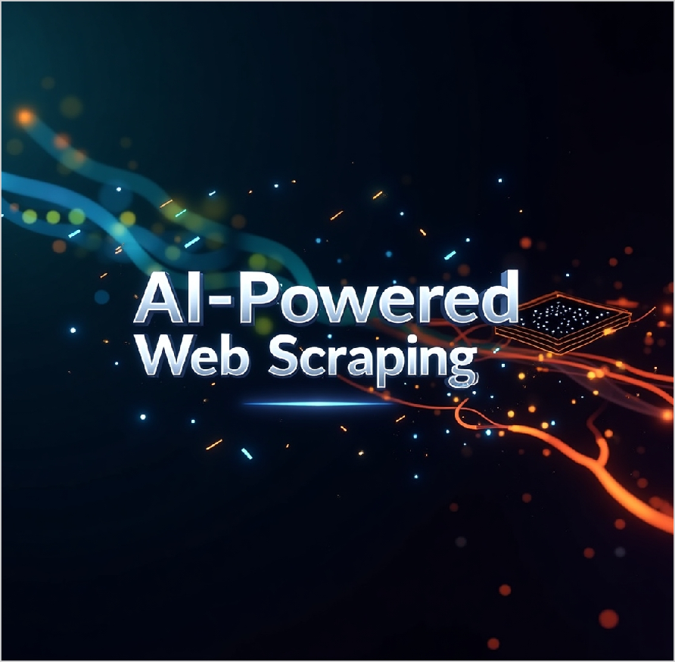
Thank
You!
Empower data-driven decisions with AI- powered web scraping, making information extraction effortless, accurate, and ethical for businesses worldwide.

